Slide 1

Analysis of Algorithms
Dr. Aiman Hanna
Department of Computer Science & Software Engineering
Concordia University, Montreal, Canada
These slides has been extracted, modified and updated from original slides of :
Data Structures and Algorithms in Java, 5th edition. John Wiley& Sons, 2010. ISBN 978-0-470-38326-1.
Data Structures and the Java Collections Framework by William J. Collins, 3rdedition, ISBN 978-0-470-48267-4. Both books are published by Wiley.
Copyright © 2010-2011 Wiley
Copyright © 2010 Michael T. Goodrich, Roberto Tamassia
Copyright © 2011 William J. Collins
Copyright © 2011-2012 Aiman Hanna
All rights reserved
Analysis of Algorithms

Slide 2
How to Estimate Efficiency?
Correctness of a method depends merely on whether the algorithm performs what it is supposed to do.
Clearly, efficiency is hence different than correctness.
Efficiency can be measured in many ways; i.e:
  Less memory utilization
  Faster execution time
  Quicker release of allocated recourses
  etc.
How efficiency can then be measured?
  Measurement should be independent of used software (i.e. compiler, language, etc.) and hardware (CPU speed, memory size, etc.)
  Particularly, run-time analysis can have serious weaknesses
Analysis of Algorithms

Slide 3
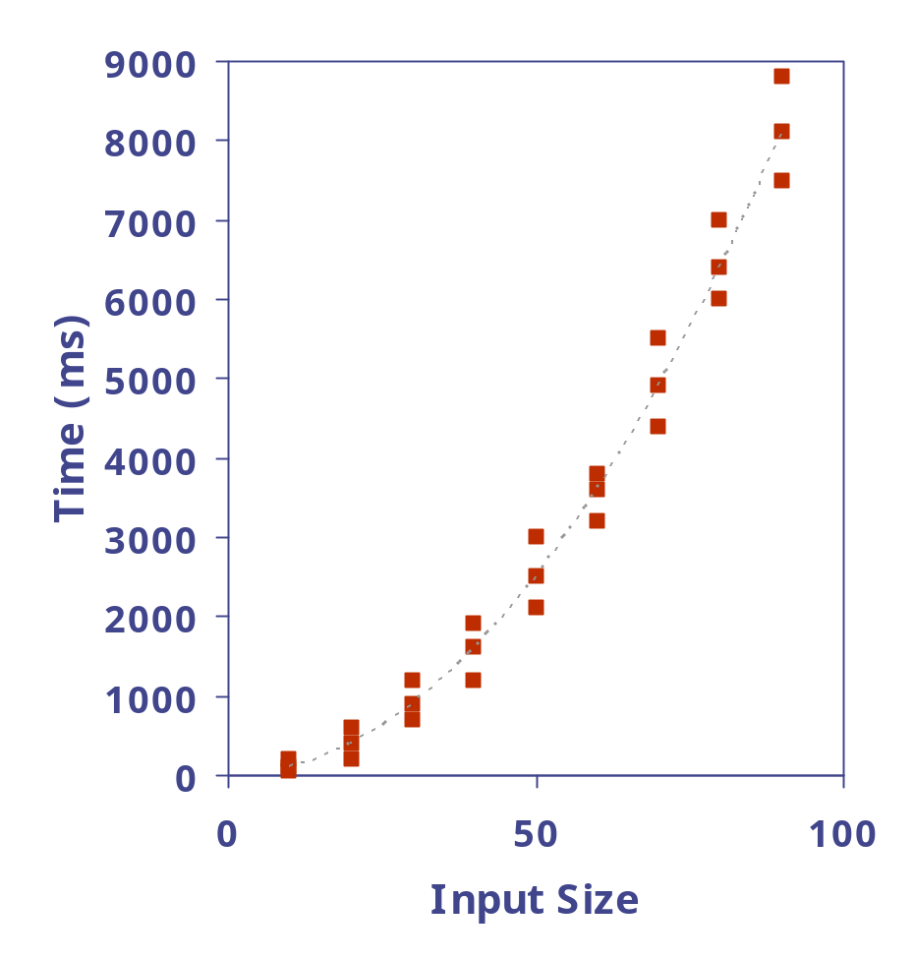
Experimental Studies
Write a program implementing the algorithm.
Run the program with inputs of varying size and composition.
Use a method like System.currentTimeMillis() to get an accurate measure of the actual running time.
Plot the results.
Analysis of Algorithms

Slide 4
Limitations of Experiments
It is necessary to implement the algorithm, which may be difficult/costly.
Results may not be indicative of the running time on other inputs not included in the experiment.
In order to compare two algorithms, the same hardware and software environments must be used
In some multiprogramming environments, such as Windows, it is very difficult to determine how long a single task takes (since there is so much going behind the scene).
Analysis of Algorithms

Slide 5
How to Estimate Efficiency?
Efficiency, to a great extent, depends on how the method is defined.
An abstract analysis that can be performed by direct investigation of the method definition is hence preferred.
Ignore various restrictions; i.e:
  CPU speed
  Memory limits; for instance allow an int variable to take any allowed integer value, and allow arrays to be arbitrarily large
  etc.
Since the method is now unrelated to specific computer environment, we refer to it as algorithm.
Analysis of Algorithms

Slide 6
Estimating Running Time
How can we estimate the running/execution-time from algorithm’s definition?
Consider the number of executed statements, in a trace of the algorithm, as a measurement of running- time requirement.
This measurement can be represented as function of the “size” of the problem.
The running time of an algorithm typically grows with the input size.
Analysis of Algorithms

Slide 7
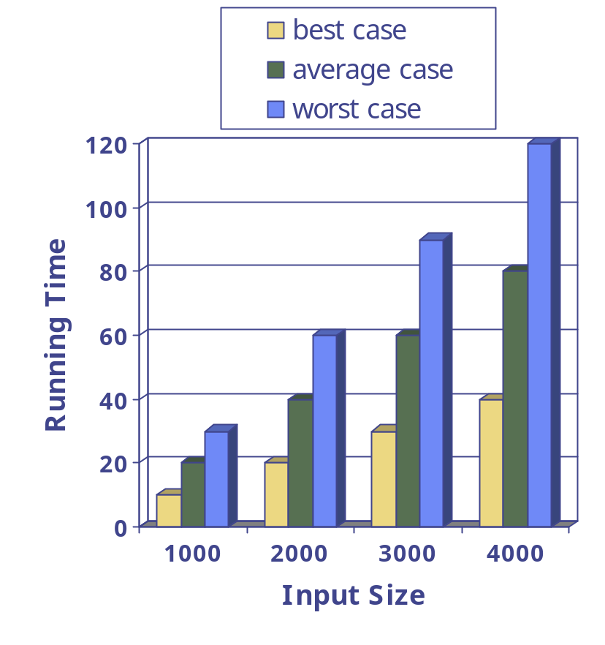
Estimating Running Time
We focus on the worst case of running time since this is crucial to many applications such as games, finance, robotics, etc.
Given a method of a problem of size n, find worstTime(n) , which is the maximum number of executed statements in a trace, considering all possible parameters/input values.
Analysis of Algorithms

Slide 8
Estimating Running Time
Example:
Assume an array a [0 … n –1] of int, and assume the following trace:
    for (int i = 0; i < n - 1; i++)
    if (a [i] > a [i + 1])
    System.out.println (i);
What is worstTime(n)?
Analysis of Algorithms

Slide 9
Estimating Running Time
That is, worstTime(n) is: 4n – 2.
Statement | Worst Case Number of Executions
i = 0 | 1
i < n – 1 | n
i++ | n - 1
a[i] > a[i+1] | n - 1
System.out.println() | n - 1
Analysis of Algorithms

Slide 10
Estimating Running Time
➔ See aboveMeanCount() method
What is worstTime(n)?
Analysis of Algorithms

Slide 11
Estimating Running Time
worstTime(n ) of aboveMeanCount() method
Statements | Worst # of Executions
double[] a, double mean (assignment of 1st & 2nd arguments) | 1 + 1
n = a.length, count = 0 | 1 + 1
i = 0, return count | 1 + 1
i < n | n + 1
i++ | n
a[i] > mean | n
count++ | n – 1
 | = 4n + 6
Analysis of Algorithms

Slide 12
Pseudocode
Example: find max element of an array
High-level description of an algorithm.
More structured than English prose.
Less detailed than a program.
Preferred notation for describing algorithms
Hides program design issues.
Algorithm arrayMax(A, n)
Input array A of n integers
Output maximum element of A
currentMax ← A[0]
for i ← 1 to n − 1 do
if A[i] > currentMax then
currentMax ← A[i]
return currentMax
Analysis of Algorithms

Slide 13
Pseudocode Details
Control flow
  if … then … [else …]
  while … do …
  repeat … until …
  for … do …
  Indentation replaces braces
Method declaration
  Algorithm method (arg [, arg…])
  Input …
  Output …
Method call
  var.method (arg [, arg…])
Return value
  return expression
Expressions
  Assignment
  (like = in Java)
  Equality testing
  (like == in Java)
  n² Superscripts and other mathematical formatting allowed
Analysis of Algorithms

Slide 14
The Random Access Machine (RAM) Model
A CPU.
An potentially unbounded bank of memory cells, each of which can hold an arbitrary number or character.
2
1
0
Memory cells are numbered and accessing any cell in memory takes unit time.
Analysis of Algorithms

Slide 15
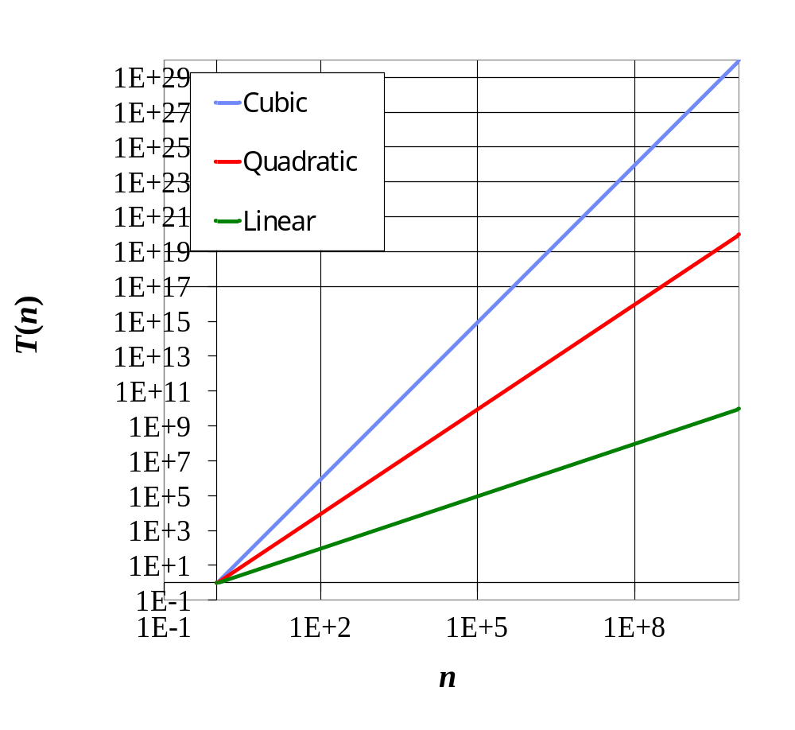
Seven Important Functions
Seven functions often appear in algorithm analysis:
  Constant ≈ 1
  Logarithmic ≈ log n
  Linear ≈ n
  N-Log-N ≈ n log n
  Quadratic ≈ n²
  Cubic ≈ n³
  Exponential ≈ 2^{n}
Analysis of Algorithms

Slide 16
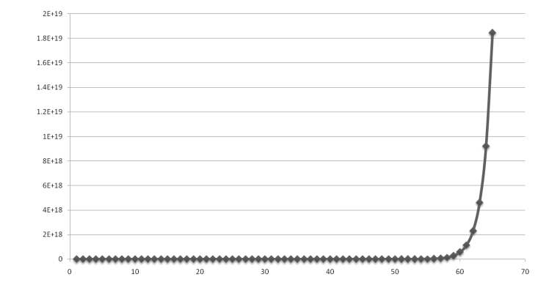
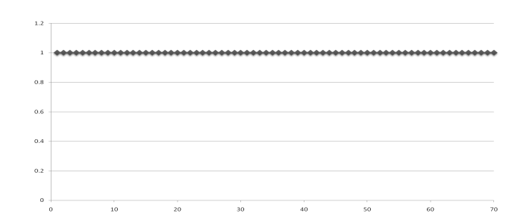
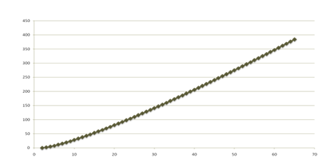
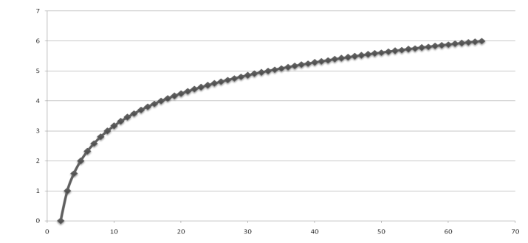
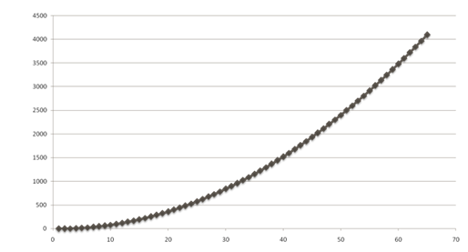
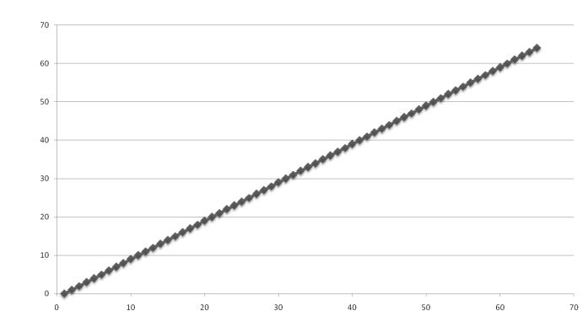
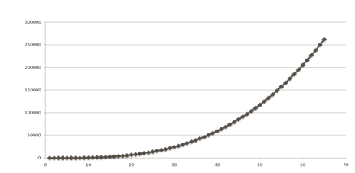
Functions Graphed
Using “Normal” Scale
Slide by Matt Stallmann included with permission.
g(n) = n lg n
g(n) = 1
g(n) = 2^{n}
g(n) = n²
g(n) = lg n
g(n) = n
g(n) = n³
Analysis of Algorithms

Slide 17

Primitive Operations
Basic computations performed by an algorithm.
Identifiable in pseudocode.
Largely independent from the programming language.
Exact definition not important (we will see why later).
Assumed to take a constant amount of time in the RAM model.
Examples:
  Evaluating an expression
  Assigning a value to a variable
  Indexing into an array
  Calling a method
  Returning from a method
Analysis of Algorithms

Slide 18
Counting Primitive Operations
By inspecting the pseudocode, we can determine the maximum number of primitive operations executed by an algorithm, as a function of the input size.
Algorithm compareValues(A, n)
Input array A of n integers
Output display all elements larger than following ones
# of operations
for i ← 0 to n − 2 do n − 1
if A[i] > A[i+1] then n − 1
display i n − 1
increment counter i n − 1
Total 4n − 4
Analysis of Algorithms

Slide 19

Estimating Running Time
Algorithm compareValues executes 4n − 4 primitive operations in the worst case.
Define:
  a = Time taken by the fastest primitive operation
  b = Time taken by the slowest primitive operation
Let T(n) be the running time of compareValues. Then
a (4n − 4) ≤ T(n) ≤ b(4n − 4)
Hence, the running time T(n) is bounded by two linear functions
Analysis of Algorithms

Slide 20

Growth Rate of Running Time
Changing the hardware/ software environment
  Affects T(n) by a constant factor, but
  Does not alter the growth rate of T(n)
The linear growth rate of the running time T(n) is an intrinsic property of algorithm compareValues
Analysis of Algorithms

Slide 21
Why Growth Rate Matters
Slide by Matt Stallmann included with permission.
if runtime is... | time for n + 1 | time for 2 n | time for 4 n
c log n | c log (n + 1) | c (log n + 1) | c(log n + 2)
c n | c (n + 1) | 2c n | 4c n
c n log n | ~ c n log n + c n | 2c n log n + 2cn | 4c n log n + 4cn
c n² | ~ c n² + 2c n | 4c n² | 16c n²
c n³ | ~ c n³ + 3c n² | 8c n³ | 64c n³
c 2^{n} | c 2 ^{n+1} | c 2 ^{2n} | c 2 ^{4n}
runtime
quadruples
when problem
size doubles
Analysis of Algorithms

Slide 22
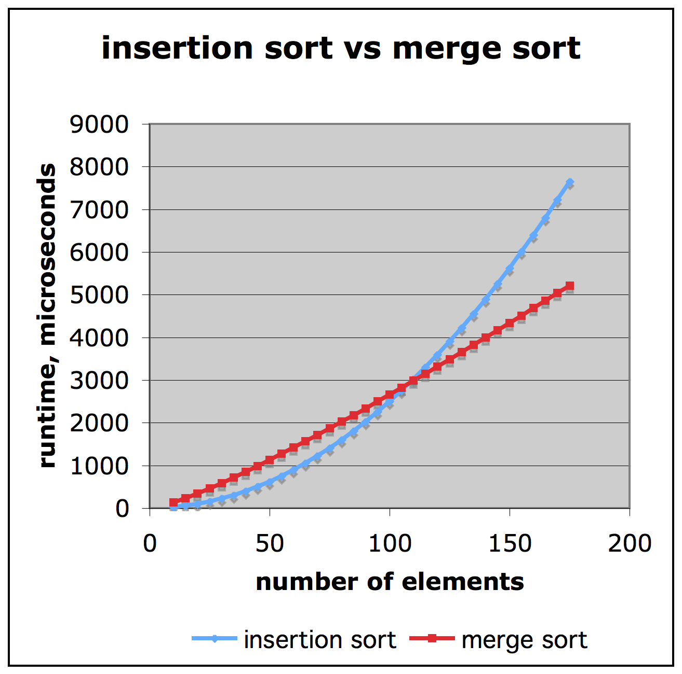
Comparison of Two Algorithms
Slide by Matt Stallmann included with permission.
insertion sort is
n² / 4
merge sort is
2 n lg n
sort a million items?
insertion sort takes
roughly 70 hours
while
merge sort takes
roughly 40 seconds
This is a slow machine, but if
100 x as fast then it’s 40 minutes
versus less than 0.5 seconds
Analysis of Algorithms

Slide 23
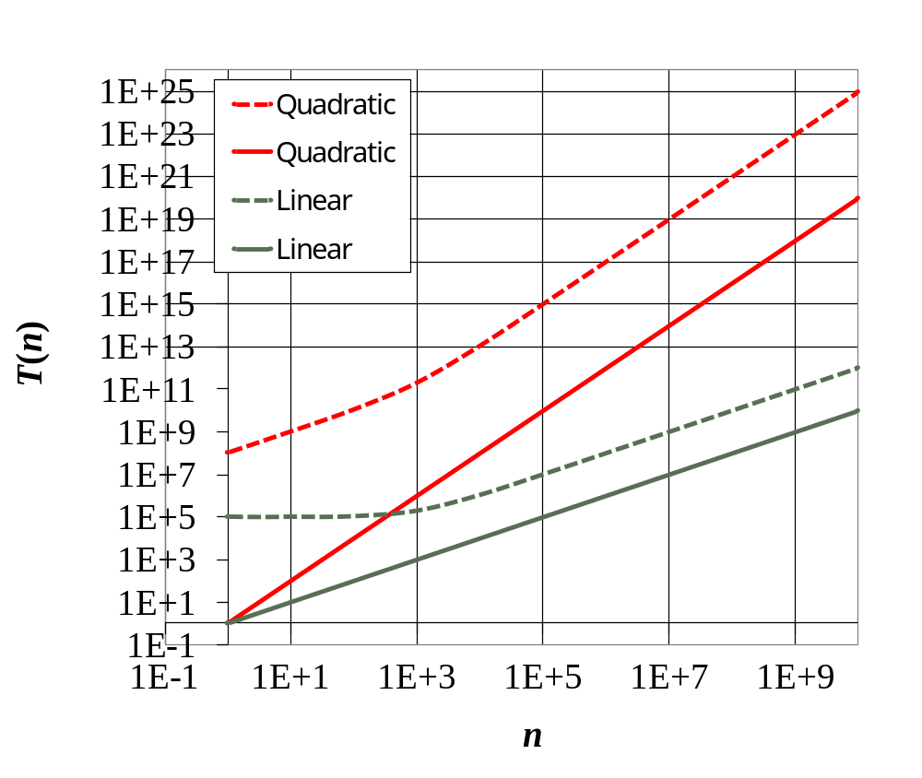
Constant Factors
The growth rate is not affected by
  constant factors or
  lower-order terms
Examples
  10²n + 10⁵ is a linear function
  10⁵n² + 10⁸n is a quadratic function
Analysis of Algorithms

Slide 24
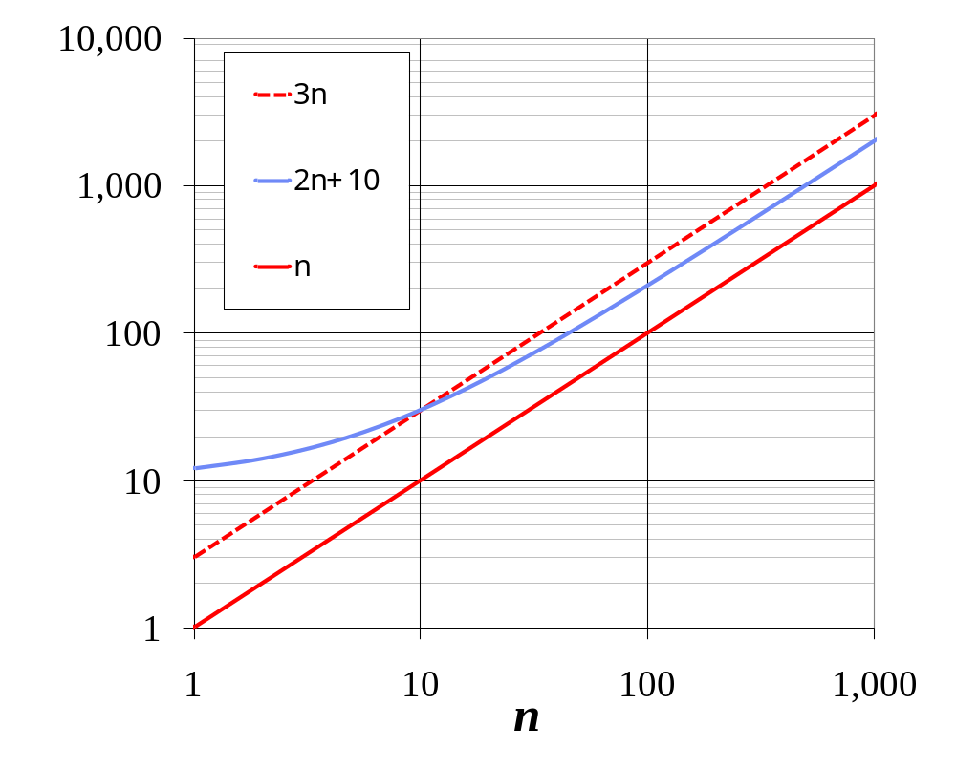
Big-O Notation
We do NOT need to calculate the exact worst time since it is only an approximation of time requirements.
Instead, we can just approximate that time by means of “Big-O” notation.
That is quite satisfactory since it gives us approximation of an approximation!
Analysis of Algorithms

Slide 25
Big-O Notation
The basic idea is to determine an upper bound for the behavior of the algorithm/function.
In other words, to determine how bad the performance of the algorithm can get!
If some function g(n) is an upper bound of function f(n), then we say that f(n) is Big-O of g(n).
Analysis of Algorithms

Slide 26
Big-O Notation
Specifically, Big-O is defined as follows: Given functions f(n) and g(n), we say that f(n) is O(g(n)) if there are positive constants c and n₀ such that
f(n) ≤ cg(n) for n ≥ n₀
The idea is that if f(n) is O(g(n)) then it is bounded above (can not get bigger than) some constant times g(n).
Analysis of Algorithms

Slide 27
Big-O Notation
Further, by a standard abuse of notation, we often associate a function with the value is calculates.
For instance, if g(n) = n³, for n = 0, 1, 2,….,
then instead of saying that f(n) is O(g(n)), we say
f(n) is O(n³).
Analysis of Algorithms

Slide 28
Big-O Notation
Example 1: What is O() if f(n) = 2n + 10?
  2n ≤ 2n for n ≥ 0
  10 ≤ 10n for n ≥ 1
  So, for any n ≥ 1
  2n + 10 ≤ 12n ➔ consider c = 12, n₀ = 1 ➔ g(n) = n
  Consequently, the above f(n) is O(n).
Analysis of Algorithms

Slide 29
Big-O Notation
In general, if f(n) is a polynomial function, which is of the form:
a_{i}n^{i} + a_{i - 1}n^{i – 1} + a_{i - 2}n^{i – 2} + … + a₁n + a₀
  Then, we can directly establish that f(n) is O(n^{i}).
  Proof:
  Choose
  n₀ = 1, and
  c = |a_{i}| + |a_{i – 1}| + |a_{i – 2}| + … + |a₁| + |a₀|
Analysis of Algorithms

Slide 30
Big-O Notation
Example 2: What is O() if
f(n) = 3n⁴ + 6n³ + 10n² + 5n + 4?
  3n⁴ ≤ 3n⁴ for n ≥ 0
  6n³ ≤ 6n⁴ for n ≥ 0
  10n² ≤ 10n⁴ for n ≥ 0
  5n ≤ 5n⁴ for n ≥ 0
  4 ≤ 4n⁴ for n ≥ 1
  So, for any n ≥ 1
  3n⁴ + 6n³ + 10n² + 5n + 4 ≤ 28n⁴ ➔ consider c = 28, n₀ = 1 ➔ g(n) = n⁴
  Consequently, the above f(n) is O(n⁴).
Analysis of Algorithms

Slide 31
Big-O Notation
When determining O(), we can (and actually do) ignore the logarithmic base.
  Proof:
  Assume that f(n) is O(log_{a} n), for some positive constant a.
  Then f(n) ≤ C * log_{a} n
  for some positive constant C and some n₀ ≤ n
  By logarithmic fundamentals,
  log_{a} n = log_{a} b * log_{b} n, for any n > 0
  Let C1 = C * log_{a} b. Then for all n ≥ n₀
  f(n) ≤ C * log_{a} n = C * log_{a} b * log_{b} n = C1 * log_{b} n
  ➔ f(n) is O(log_{b} n).
Analysis of Algorithms

Slide 32
Big-O Notation
Example 3: What is O() if
f(n) = 3 log n + 5
  3 log n ≤ 3 log n for n ≥ 1
  5 ≤ 5 log n for n ≥ 2
  So, for any n ≥ 2
  3 log n + 5 ≤ 8 log n ➔ consider c = 8, n₀ = 2
  ➔ g(n) = log n
  Consequently, the above f(n) is O(log n).
Analysis of Algorithms

Slide 33
Big-O Notation
Nested loops are significant when estimating O().
Example 4:
  Consider the following loop segment, what is O()?
      for (int i = 0; i < n; i++ )
      for (int j = 0; j < n; j++ )
      ……………
  The outer loop has 1 + (n + 1) + n executions.
  The inner loop has n(1 + (n + 1) + n ) executions.
  Total is: 2n² + 4n + 2 ➔ O(n²).
  Hint: As seen in Example 2 for polynomial functions
Analysis of Algorithms

Slide 34
Big-O Notation
Important Note: Big-O only gives an upper bound of the algorithm.
However, if f(n) is O(n), then it is also
O(n + 10), O(n³), O(n² + 5n + 7), O(n¹⁰), etc.
We, generally, choose the smallest element from this hierarchy of orders.
For example, if f(n) = n + 5, then we choose O(n), even though f(n) is actually also O(n log n), O(n⁴), etc.
Similarly, we write O(n) instead of O(2n + 8), O(n – log n), etc.
Analysis of Algorithms

Slide 35
Big-O Notation
Elements of the Big-O hierarchy can be as:
O(1) ⊂ O(log n) ⊂ O(n^{½}) ⊂ O(n) ⊂ O(n log n) ⊂ O(n²) ⊂ O(n³) ⊂ …….. ⊂ O(2^{n}) ⊂ ……..
Where the symbol “⊂”, indicates “is contained in”.
Analysis of Algorithms

Slide 36
Big-O Notation
The following table provides some examples:
Sample Functions | Order of O()
f(n) = 3000 | O(1)
f(n) = (n * log₂(n+1) + 2) / (n+1) | O(log n)
f(n) = (500 log₂ n) + n / 100000 | O(n)
f(n) = (n * log₁₀ n) + 4n + 8 | O(n log n)
f(n) = n * (n + 1) / 2 | O(n²)
f(n) = 3500 n¹⁰⁰ + 2^{n} | O(2^{n})
Analysis of Algorithms

Slide 37
Big-O Notation
Warning: One danger of Big-O is that it can be misleading when the values of n are small.
For instance, consider the following two functions
f(n) and g(n) for n ≥ 0
f(n) = 1000 n ➔ f(n) is hence O(n)
g(n) = n² / 10 ➔ g(n) is hence O(n²)
However, and despite of the fact that g(n) has a higher/worst order than the one of f(n), f(n) is actually greater than g(n), for all values of n less than 10,000!
Analysis of Algorithms

Slide 38
Finding Big-O Estimates Quickly
Case 1: Number of executions is independent of n ➔ O(1)
Example:
  // Constructor of a Car class
  public Car(int nd, double pr)
  {
  numberOfDoors = nd;
  price = pr;
  }
  Example:
  for (int j = 0; j < 10000; j++ )
  System.out.println(j);
Analysis of Algorithms

Slide 39
Finding Big-O Estimates Quickly
Case 2: The splitting rule ➔ O(log n)
Example:
  while(n > 1)
  {
  n = n / 2;
  …;
  }
  Example:
  See the binary search method in Recursion6.java & Recursion7.java
Analysis of Algorithms

Slide 40
Finding Big-O Estimates Quickly
Case 3: Single loop, dependent on n ➔ O(n)
Example:
  for (int j = 0; j < n; j++ )
  System.out.println(j);
  Note: It does NOT matter how many simple statement (i.e. no inner loops) are executed in the loop. For instance, if the loop has k statements, then there is k*n executions of them, which will still lead to O(n).
Analysis of Algorithms

Slide 41
Finding Big-O Estimates Quickly
Case 4: Double looping dependent on n & splitting ➔ O(n log n)
Example:
  for (int j = 0; j < n; j++ )
  {
  m = n;
  while (m > 1)
  {
  m = m / 2;
  …;
  // Does not matter how many statements are here
  }
  }
Analysis of Algorithms

Slide 42
Finding Big-O Estimates Quickly
Case 4: Double looping dependent on n
➔ O(n²)
Example:
  for (int i = 0; i < n; i++ )
  for (int j = 0; j < n; j++ )
  {
  …;
  // Does not matter how many statements are here
  }
Analysis of Algorithms

Slide 43
Finding Big-O Estimates Quickly
Case 4 (Continues): Double looping dependent on n
➔ O(n²)
Example:
  for (int i = 0; i < n; i++ )
  for (int j = i; j < n; j++ )
  {
  …;
  // Does not matter how many statements are here
  }
  The number of executions of the code segment is as follows: n + (n-1) + (n-2) + … + 3 + 2 + 1
  Which is: n(n + 1) / 2 = ½ n² + ½ n ➔ O(n²)
Analysis of Algorithms

Slide 44
Finding Big-O Estimates Quickly
Case 5: Sequence of statements with different O( )
O(g₁(n)) + O(g₂(n)) + … = O(g₁(n) + g₂(n) + …)
Example:
  for (int i = 0; i < n; i++ )
  { ...
  }
  for (int i = 0; i < n; i++ )
  for (int j = i; j < n; j++ )
  { ...
  }
  The first loop is O(n) and the second is O(n²). The entire segment is hence O(n) + O(n²), which is equal to O(n + n²), which is in this case O(n² ).
Analysis of Algorithms

Slide 45
Asymptotic Algorithm Analysis
In computer science and applied mathematics, asymptotic analysis is a way of describing limiting behaviours (may approach ever nearer but never crossing!).
Asymptotic analysis of an algorithm determines the running time in big-O notation.
To perform the asymptotic analysis
  We find the worst-case number of primitive operations executed as a function of the input size
  We then express this function with big-O notation
Analysis of Algorithms

Slide 46
Asymptotic Algorithm Analysis
Example:
  We determine that algorithm compareValues executes at most 4n − 4 primitive operations
  We say that algorithm compareValues “runs in O(n) time”, or has a “complexity” of O(n)
Note: Since constant factors and lower-order terms are eventually dropped anyhow, we can disregard them when counting primitive operations.
Analysis of Algorithms

Slide 47
Asymptotic Algorithm Analysis
If two algorithms A & B exist for solving the same problem, and, for instance, A is O(n) and B is O(n²), then we say that A is asymptotically better than B (although for a small time B may have lower running time than A).
To illustrate the importance of the asymptotic point of view, let us consider three algorithms that perform the same operation, where the running time (in µs) is as follows, where n is the size of the problem:
  Algorithm1: 400n
  Algorithm2: 2n²
  Algorithm3: 2^{n}
Analysis of Algorithms

Slide 48
Asymptotic Algorithm Analysis
  Which of the three algorithms is faster?
    Notice that Algorithm1 has a very large constant factor compared to the other two algorithms!
Running Time ( µs) | Maximum Problem Size (n) that can be solved in:
 | 1 Second | 1 Minute | 1 Hour
Algorithm 1 400n | 2,500 (400 * 2,500 = 1000,000) | 150,000 | 9 Million
Algorithm 2 2n² | 707 (2 * 707² ≈ 1000,000) | 5,477 | 42,426
Algorithm 3 2^{n} | 19 (only 19, since 2²⁰ would exceed 1000,000) | 25 | 31
Analysis of Algorithms

Slide 49

Asymptotic Algorithm Analysis
Let us further illustrate asymptotic analysis with two algorithms that would compute prefix averages.
Given an array X storing n numbers, we need to construct an array A such that:
  A[i] is the average of X[0] + X[1] + … + X[i])
Analysis of Algorithms

Slide 50
Asymptotic Algorithm Analysis
That is, the i-th prefix average of an array X is average of the first (i + 1) elements of X:
A[i] = (X[0] + X[1] + … + X[i])/(i+1)
Computing prefix average has applications to financial analysis; for instance the average annual return of a mutual fund for the last year, three years, ten years, etc.
Analysis of Algorithms

Slide 51
Prefix Averages (Quadratic)
The following algorithm computes prefix averages in quadratic time (n²) by applying the definition
Algorithm prefixAverages1(X, n)
Input array X of n integers
Output array A of prefix averages of X # of operations
A ← new array of n integers n
for i ← 0 to n − 1 do n
s ← X[0] n
for j ← 1 to i do 1 + 2 + …+ (n − 1)
s ← s + X[j] 1 + 2 + …+ (n − 1)
A[i] ← s / (i + 1) n
return A 1
Analysis of Algorithms

Slide 52
Prefix Averages (Quadratic)
Hence, to calculate the sum n integers, the algorithm needs (from the segment that has the two loops) n(n + 1) / 2 operations.
In other words, prefixAverages1 is
O(1 + 2 + …+ n) = O(n(n + 1) / 2) ➔ O(n²)
Analysis of Algorithms

Slide 53
Prefix Averages (Linear)
The following algorithm computes prefix averages in linear time (n) by keeping a running sum
Algorithm prefixAverages2(X, n)
Input array X of n integers
Output array A of prefix averages of X # of operations
A ← new array of n integers n
s ← 0 1
for i ← 0 to n − 1 do n
s ← s + X[i] n
A[i] ← s / (i + 1) n
return A 1
Algorithm prefixAverages2 runs in O(n) time, which is clearly better than prefixAverages1.
Analysis of Algorithms

Slide 54
Big-Omega, Big-Theta &
Plain English!
In addition to Big-O, there are two other notations that are used for algorithm analysis: Big-Omega and Big-Theta.
While Big-O provides an upper bound of a function, Big-Omega provides a lower bound.
In other words, while Big-O indicates that an algorithm behavior “cannot be any worse than”, Big-Omega indicates that it “cannot be any better than”.
Analysis of Algorithms

Slide 55
Big-Omega, Big-Theta &
Plain English!
Logically, we are often interested in worst-case estimations, however knowing the lower bound can be significant when trying to achieve an optimal solution.
big-Omega
Big-Omega is defined as follows: Given functions f(n) and g(n), we say that f(n) is Ω(g(n)) if there are positive constants c and n₀ such that
f(n) ≥ cg(n) for n ≥ n₀
Analysis of Algorithms

Slide 56
Big-Omega, Big-Theta &
Plain English!
Example: 3n log n + 2n is Ω(n log n)
    Proof:
    3n log n + 2n ≥ 3n log n ≥ n log n
    for every n ≥ 1
Example: 3n log n + 2n is Ω(n)
    Proof:
    3n log n + 2n ≥ 2n ≥ n
    for every n ≥ 1
Analysis of Algorithms

Slide 57
Big-Omega, Big-Theta &
Plain English!
Notice that: … Ω(2^{n}) ⊂ Ω(n³) ⊂ Ω(n²) ⊂ Ω(n log n) ⊂ Ω(n) ⊂ Ω(n^{½}) ⊂ … ⊂ Ω(log n) ⊂ … ⊂ Ω(1)
Where the symbol “⊂”, indicates “is contained in”.
It should be noted that in “many” cases, a method that is O( ) is also Ω( ).
Analysis of Algorithms

Slide 58
Big-Ω
Example 1 (Revised): What are O() and Ω()
if f(n) = 2n + 10?
As seen before, the method is O(n).
Now,
  2n + 10 ≥ 2n ≥ n for n ≥ 0
  So, for any n ≥ 0
  2n + 10 ≥ n ➔ consider c = 1, n₀ = 0 ➔ Ω(n) = n
  Consequently, the above f(n) is O(n),
  and is also Ω(n) .
Analysis of Algorithms

Slide 59
Big-Ω
Example 2 (Revised): What are O() and Ω() if
f(n) = 3n⁴ + 6n³ + 10n² + 5n + 4?
As seen before, the method is O(n⁴).
Now,
  3n⁴ + 6n³ + 10n² + 5n + 4 ≥ 3n⁴ for n ≥ 0
  3n⁴ ≥ n⁴ for n ≥ 0
  So, for any n ≥ 0
  3n⁴ + 6n³ + 10n² + 5n + 4 ≥ n⁴
  ➔ consider c = 1, n₀ = 0 ➔ g(n) = n⁴
  Consequently, the above f(n) is
  O(n⁴) and is also Ω(n⁴) .
Analysis of Algorithms

Slide 60
Big-Ω
However, Big-O and Big-Omega are distinct.
That is, there are cases when a function may have different O( ) and Ω( ).
A simple, and somehow artificial, proof of that can be provided as follows:
  Assume f(n) = n for n = 0, 1,2, …
  Clearly f(n) is O(n), and hence is O(n²)
  Yet, f(n) is NOT Ω(n²)
  Also, since f(n) is Ω(n), it is also Ω(1)
  Yet, f(n) is NOT O(1)
Analysis of Algorithms

Slide 61
Big-Ω
In fact, as seen, the hierarchy of Ω() is just the reverse of the one of O()
For example, the following code segment:
    for (int j = 0; j < n; j++)
    System.out.println (j);
is: O(n), O(n log n), O(n²), …
And is also:
Ω(n), Ω(log n), Ω(1)
Analysis of Algorithms

Slide 62
Big-O, Big-Omega, Big-Theta &Plain English!
Big-O provides and upper bound of a function, while Big-Ω provides a lower bound of it.
In many, if not most, cases, there is often a need of one function that would serve as both lower and upper bounds; that is Big-Theta (Big-Θ).
Analysis of Algorithms

Slide 63
Big-O, Big-Omega, Big-Theta &Plain English!
big-Theta
Big-Theta is defined as follows: Given functions f(n) and g(n), we say that f(n) is Θ(g(n)) if there are positive constants c₁, c₂ and n₀ such that
c₁g(n) ≤ f(n) ≤ c₂g(n) for n ≥ n₀
Simply put, if a function is f(n) is Θ(g(n)), then it is bounded above and below by some constants time g(n); in other words, it is, roughly, bounded above and below by g(n).
→ Notice that if f(n) is Θ(g(n)), then it is hence both O(g(n)) and Ω(g(n)).
Analysis of Algorithms

Slide 64
Big-Θ
Example 2 (Revised Again): What is Θ() of the following function:
f(n) = 3n⁴ + 6n³ + 10n² + 5n + 4?
As seen before, the function is O(n⁴) and also is Ω(n⁴)
➔ Hence, it is Θ(n⁴).
Analysis of Algorithms

Slide 65
Big-O, Big-Ω & Big-Θ
Quick Examples
5n² is Ω(n²)
  f(n) is Ω(g(n)) if there is a constant c > 0 and an integer constant n₀ ≥ 1 such that f(n) ≥ c•g(n) for n ≥ n₀
  let c = 5 and n₀ = 1
5n² is Ω(n)
  f(n) is Ω(g(n)) if there is a constant c > 0 and an integer constant n₀ ≥ 1 such that f(n) ≥ c•g(n) for n ≥ n₀
  let c = 1 and n₀ = 1
5n² is Θ(n²)
  f(n) is Θ(g(n)) if it is Ω(n²) and O(n²). We have already seen the former, for the latter recall that f(n) is O(g(n)) if there is a constant c > 0 and an integer constant n₀ ≥ 1 such that f(n) < c•g(n) for n ≥ n₀
  Let c = 5 and n₀ = 1
Notice that 5n² is NOT Θ(n) since it is not O(n)
Analysis of Algorithms

Slide 66
Plain English
Sometimes, it might be easier to just indicate the behavior of a method through natural language equivalence of Big-Θ.
For instance
  if f(n) is Θ(n), we indicate that f is “linear in n”.
  if f(n) is Θ(n²), we indicate that f is “quadratic in n”.
Analysis of Algorithms

Slide 67
Plain English
The following table shows the English-language equivalence of Big-Θ
Big-Θ | English
Θ(c) for some constant c ≥ 0 | Constant
Θ(log n) | Logarithmic in n
Θ(n) | Linear in n
Θ(n log n) | Linear-logarithmic in n
Θ(n²) | Quadratic in n
Analysis of Algorithms

Slide 68
Big-O
We may just prefer to use plain English, such as “linear”, “quadratic”, etc..
However, in practice, there are MANY occasions when all we specify is an upper bound to the method, which is namely:
Big-O
Analysis of Algorithms

Slide 69

Intuition for Asymptotic Notation
Big-O
  f(n) is O(g(n)) if f(n) is asymptotically less than or equal to g(n)
Big-Omega
  f(n) is Ω(g(n)) if f(n) is asymptotically greater than or equal to g(n)
Big-Theta
  f(n) is Θ(g(n)) if f(n) is asymptotically equal to g(n)
Analysis of Algorithms

Slide 70
Big-O and Growth Rate
The big-O notation gives an upper bound on the growth rate of a function
The statement “f(n) is O(g(n))” means that the growth rate of f(n) is no more than the growth rate of g(n)
We can use the big-O notation to rank functions according to their growth rate
 | f(n) is O(g(n)) | g(n) is O(f(n))
g(n) grows more | Yes | No
f(n) grows more | No | Yes
Same growth | Yes | Yes
Analysis of Algorithms

Slide 71
Big-O and Growth Rate
Again, we are specifically interested in how rapidly a function increases based on its classification.
For instance, suppose that we have a method whose worstTime() estimate is linear in n, what will be the effect of doubling the problem size?
  worstTime(n) ≈ c * n, for some constant c, and sufficiently large value of n
  If the problem size doubles then worstTime(n) ≈ c * 2n ≈ 2* worstTime(n)
In other words, if n is doubled, then worst time is doubled.
Analysis of Algorithms

Slide 72
Big-O and Growth Rate
Now, suppose that we have a method whose worstTime() estimate is quadratic in n, what will be the effect of doubling the problem size?
  worstTime(n) ≈ c * n²
  If the problem size doubles then worstTime(2n) ≈ c * (2n)² = c * 4 * n² ≈ 4* worstTime(n)
In other words, if n is doubled, then worst time is quadrupled.
Analysis of Algorithms

Slide 73
Big-O and Growth Rate
worstTime(n)
O(n²)
O(n log n)
O(n)
O(log n)
O(1)
n
Analysis of Algorithms

Slide 74
Big-O and Growth Rate
Again, remember that the Big-O differences eventually dominate constant factors.
For instance if n is sufficiently large, 100 n log n will still be smaller than n² / 100.
So, the relevance of Big-O, Big-Ω or Bog-Θ may actually depend on how large the problem size may get (i.e. 100,000 or more in the above example).
Analysis of Algorithms

Slide 75
Big-O and Growth Rate
The following table provides estimate of needed execution time for various functions of n, if n = 1000,000,000, running on a machine executing 1000,1000 statements per second.
Function o f n | Time Estimate
log₂ n | .0024 Seconds
n | 17 Minutes
n log₂ n | 7 Hours
n² | 300 Years
Analysis of Algorithms

Slide 76

Math you need to Review
Summations
Logarithms and Exponents
Proof techniques
Basic probability
properties of logarithms:
  log_{b}(xy) = log_{b}x + log_{b}y
  log_{b} (x/y) = log_{b}x - log_{b}y
  log_{b}xa = alog_{b}x
  log_{b}a = log_{x}a/log_{x}b
  Log₂2n = log₂n + 1
  Log₂4n = log₂n + 2
properties of exponentials:
  a^{(b+c)} = a^{b}a ^{c}
  a^{bc} = (a^{b})^{c}
  a^{b} /a^{c} = a^{(b-c)}
  b = a ^{log}_{a}^{b}
  b^{c} = a ^{c*log}_{a}^{b}
Analysis of Algorithms

